Slide 1
Asciify Project
Coded by Alex Cruz and Daniel Spiering

Slide 2
Converting a PNG image to an ascii image
Set up the GUI
Load an Image
Convert Image Data to Grayscale
Convert Grayscale Data to Ascii Characters
Print Ascii Characters to a Text Box to Produce an Image

Slide 3
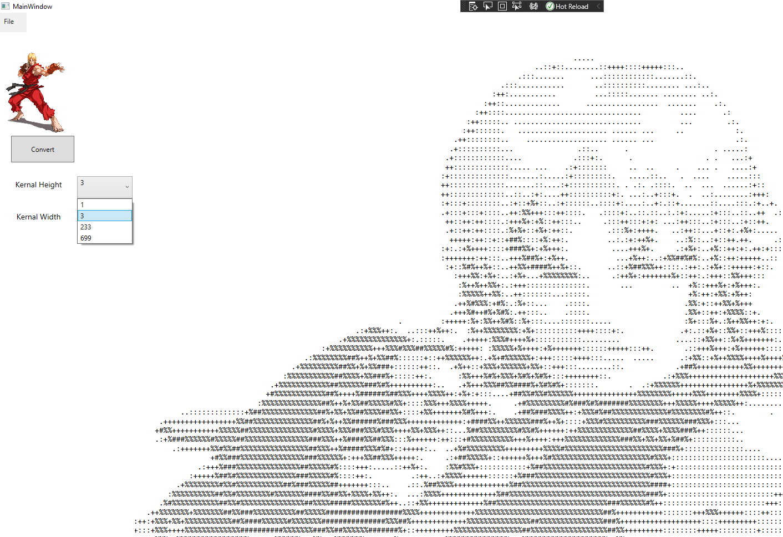
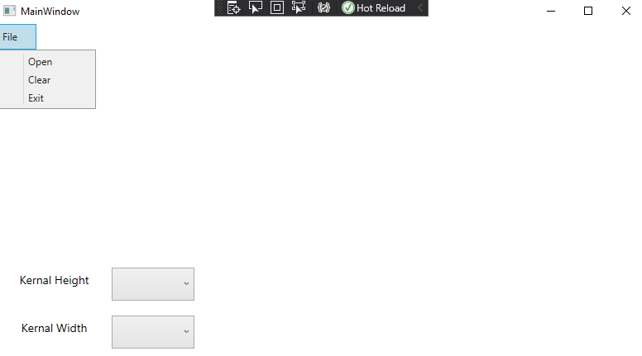
Setting up the GUI

Slide 4
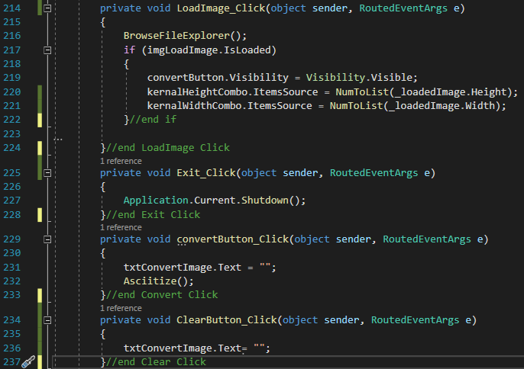
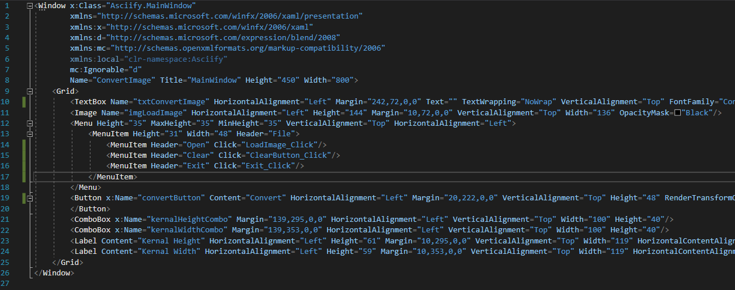
Xaml Code and click Events

Slide 5
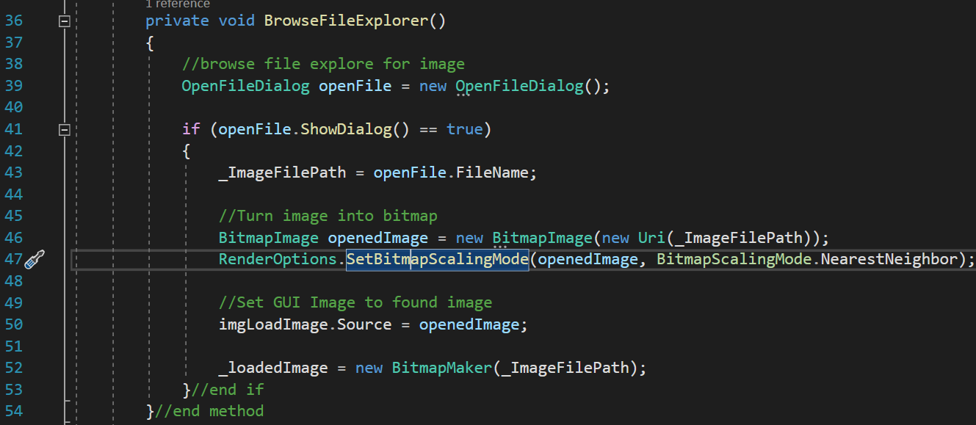
Load Image TO Convert

Slide 6
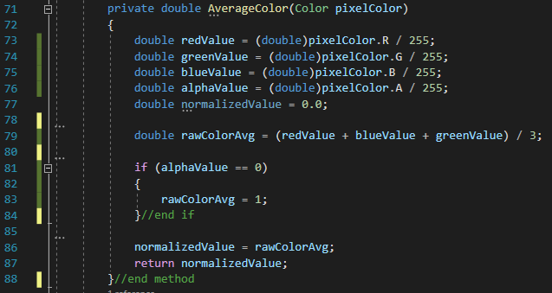
Convert Pixel Data to Grayscale

Slide 7
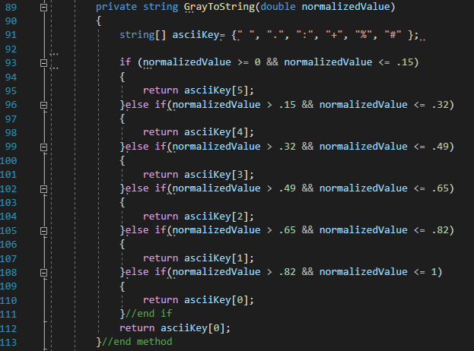
Convert Grayscale Values to Ascii Characters

Slide 8
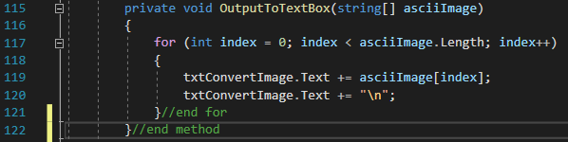
Output The Ascii Symbols To Text Box

Slide 9
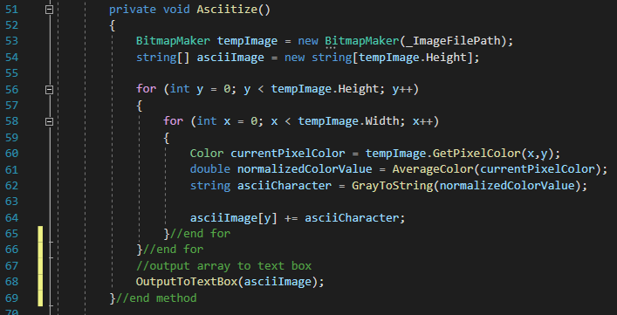
Converting Image to Ascii Image

Slide 10
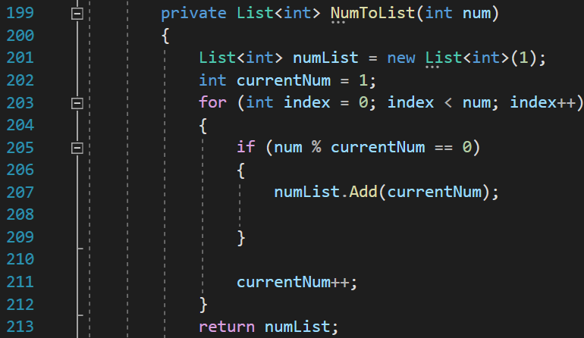
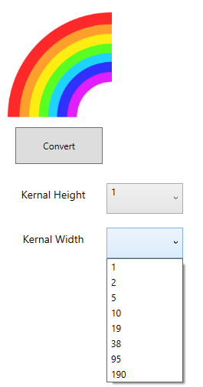
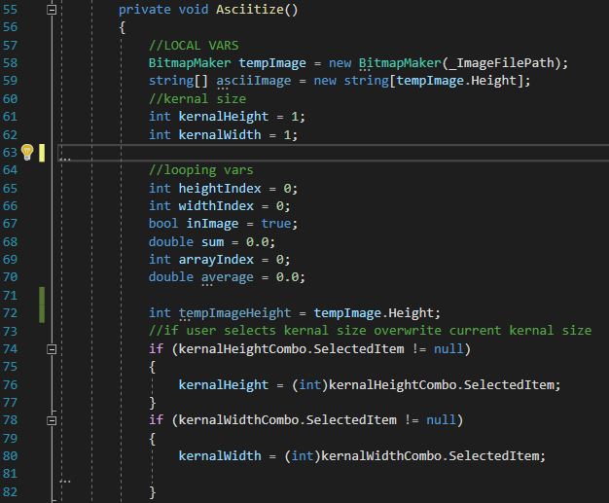
Kernel Validation

Slide 11
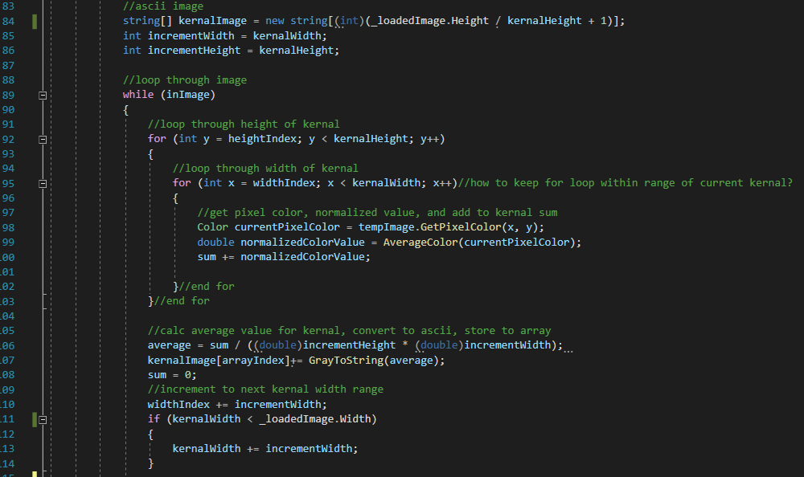
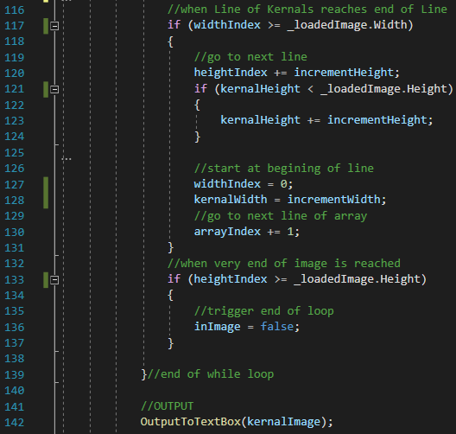
Implementation of Kernels

